Slide 1
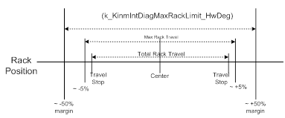
NTC Overview NTC 0x0A1 Kinematic Integrity Fault
Initialization
Periodic | X
Event
Description:
This diagnostic is responsible for detecting a condition of failed mechanical integrity between the input shaft and output shaft, where the motor coupling may have broken free from the assist mechanism and the motor starts spinning freely.
Diagnostic Overview:
This diagnostic monitors cumulative motor position (scaled to hw deg) and if this hw position exceeds a calibratable threshold ~ (maximum rack travel + tolerance), the NTC is set.
This is not a recoverable fault.
Typical Fault Response: F3 fault type.
Since motor is free spinning, the hand wheel position is not known for those systems that use motor position to help with Handwheel angle calculations. In such cases Handwheel angle dependent functions need to be disabled.
Probable Sources (Most to Least Probable):
Motor Rotations not constrained mechanically
Not connected to a R & P gear
Mechanical failure
Rev: 1.0
Modified: nn-Jan-13

Slide 2
Algorithm Changes / Lessons Learned / Revision Log
Date | FDD & Rev | Modifications to Diagnostic Function
06-13-16 | SF045A, V2.0.0 | Initial release
Description of Unusual Event setting NTC | Root Cause / Explanation
Date | Revision | Initials
06-13-16 | Initial Release | SS

